Slide 1

Application of Six Sigma in Tire Manufacturing
Submitted To:
Dr Khurram
Submitted By:
Abdullah Aamir (18-IE-15))
Haris Dilawar (18-IE-27)

Slide 2
contents
Objective
Introduction
Six Sigma
DMAIC
Methodology
Results
Conclusion

Slide 3
Objectives
To analyze the use of six sigma in tire manufacturing
To be familiar with basic techniques like probability plots, process capability index Cpk, X bar and R charts, run charts etc.
To get a in detail knowledge related to our subject of Metrology and Statistical quality control.

Slide 4
INTRODUCTION
Tire Manufacturing Process
It begins with selection of rubber as well as other raw materials including special oils, carbon black etc.
These are shaped with a homogenized unique mixture of black color with the help of gum.
Mixing process is controlled by the computerized systems to insure uniformity of the raw materials.
This mixture is processed into the sidewall, treads, or other parts of the tire.
Bead wire is made up of high carbon steel.
Bread wire of functional tire can work at pressures of 30–35 psi.

Slide 5
Six Sigma
After inception of TQM (Total Quality Management) in the early 1980s, six sigma came in picture as an element of TQM.
Six sigma is a strategy that helps to identify and eliminate the defects which leads to customer dissatisfaction.
It affects processes and performances of system.
General Electric and Motorola are two well-known companies who implemented six sigma successfully.
The term six sigma means having less than 3.4 defects per million opportunities (DPMO) or a success rate of 99.9997%.

Slide 6
DMAIC
DMAIC is most popular and useful method.
Define the problem
Measure process performance
Analyze the process to find route cause
Improve the process by eliminating route causes
Control future process performance

Slide 7
MINITAB
Minitab helps companies and institutions to spot trends, solve problems and discover valuable insights in data by delivering a comprehensive and best-in-class suite of machine learning, statistical analysis and process improvement tools.

Slide 8
METHODOLOGY (Case Study)
Tire manufacturing company in India
Company A was the leading Indian tire manufacturing who started exclusive branded outlets of truck tires. Company started its first manufacturing plant at Perambra, Kerala state of India in the year 1977. Furthermore, the company started its second manufacturing plant in Limda, Gujarat. Company expanded its business and established third plant at Kalamassery, Kerala in year 1995, where premier-type tires are produced. Then, company established a special tubes plant in the year 1996 at Ranjangoan, Maharashtra. Company increased its capacity to produce exclusive radial tires at Limda, Gujarat plant in the year 2000. In year 2004, company-initiated production of high-speed rated tubeless radial tires for passenger cars.

Slide 9
Define The Problem
Main specification range of bead splice to be produce | 90 ± 15 mm
Average bead splice of tire | 97 mm
Material loss due to Shifting of Splice from Target Specification | 93–100 kg/month
The customer complaints on wastage of material due to variation in the bead splice of a particular product

Slide 10
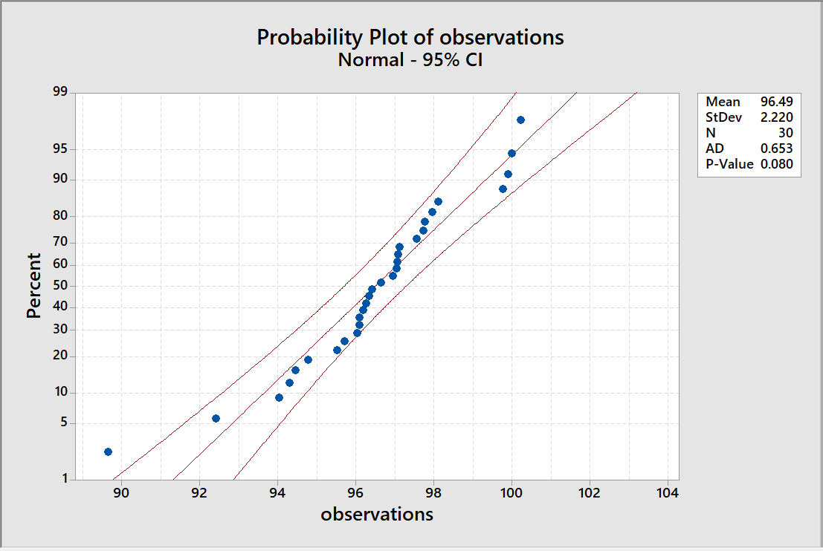
Establishment of Measures:
Initial Measures
Normality test of bead splice

Slide 11
Initial Observations
Sr. no | Observations
1 | 97.04
2 | 100.22
3 | 97.07
4 | 96.32
5 | 89.63
6 | 94.29
7 | 96.01
8 | 99.88
9 | 96.08
10 | 92.40
11 | 94.76
12 | 97.02
13 | 95.51
14 | 96.63
15 | 95.69
16 | 94.01
17 | 99.75
18 | 96.07
19 | 97.11
20 | 96.24
21 | 96.94
22 | 99.98
23 | 97.94
24 | 97.75
25 | 94.44
26 | 97.72
27 | 96.40
28 | 97.55
29 | 96.17
30 | 98.09

Slide 12
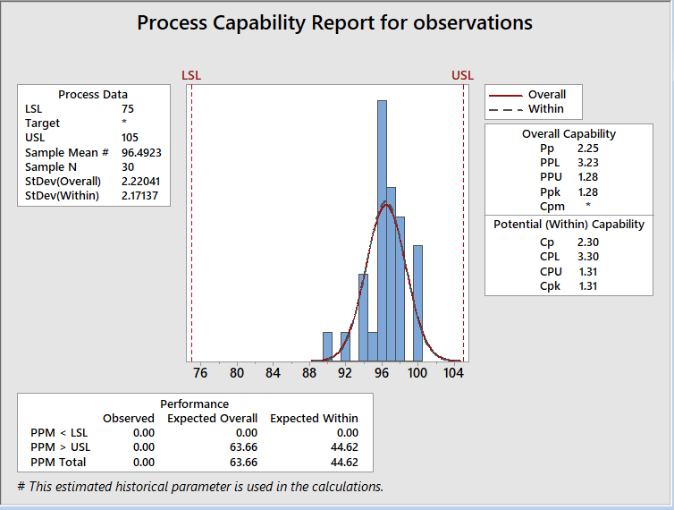
Process Capability report
Before improvement, the process capability index was found out to be 1.31

Slide 13
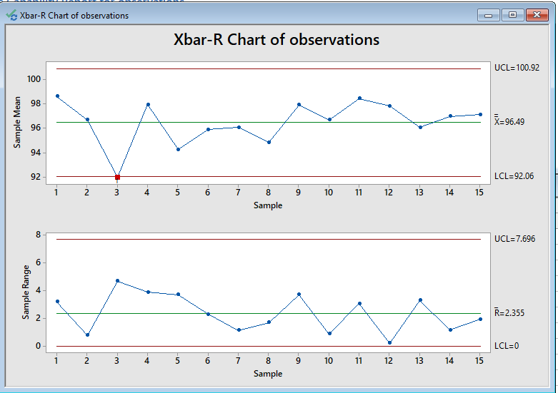
Data Analysis
In this phase, the data was analyzed, and control charts were constructed.

Slide 14
Identification Of Route Causes
First cause of the problem was bead splice setting on higher side caused by slippage of bead tape from gripper. The slippage of bead tape from gripper was generated due to worn out of the griper key.
Second cause was variation in the advancer setting caused due to change in skill of worker. This man-to-man variation was caused due to lack of the standard setup guidelines available.
The third cause was related to the frequency of sensor setting. Setting of sensors is required frequently as the former diameter changes. However, due to non-availability of guideline, sensor setting could not change frequently.
The last cause was identified that the workers were not using the measuring tape.

Slide 15
Improvement
After implementing these corrective actions, again observations were taken to measure the process performance.
The process capability index was also computed after implementing corrective actions.
After improvement in process, the capability index Cpk value is improved to 2.60 which shows that process is more capable.

Slide 16
Control
To maintain the achieved process performance of the six-sigma quality level, the above four steps of DMAIC methodology must be applied in a correct manner.

Slide 17
Final observations
Sr. No | Observations
1 | 89.0
2 | 93.1
3 | 88.9
4 | 91.1
5 | 91.5
6 | 93.6
7 | 89.6
8 | 87.9
9 | 91.2
10 | 89.1
11 | 93.8
12 | 91.1
13 | 91.1
14 | 89.1
15 | 93.0
16 | 91.1
17 | 93.0
18 | 94.0
19 | 94.3
20 | 94.0
21 | 91.4
22 | 89.1
23 | 93.1
24 | 90.4
25 | 92.8
26 | 91.3
27 | 89.2
28 | 91.4
29 | 94.1
30 | 92.9
31 | 90.1
32 | 89.2
33 | 92.9
34 | 91.4
35 | 91.9
36 | 90.1
37 | 91.2
38 | 91.1
39 | 91.5
40 | 93.1
41 | 92.6
42 | 91.7
43 | 92.8
44 | 90.0
45 | 90.1

Slide 18
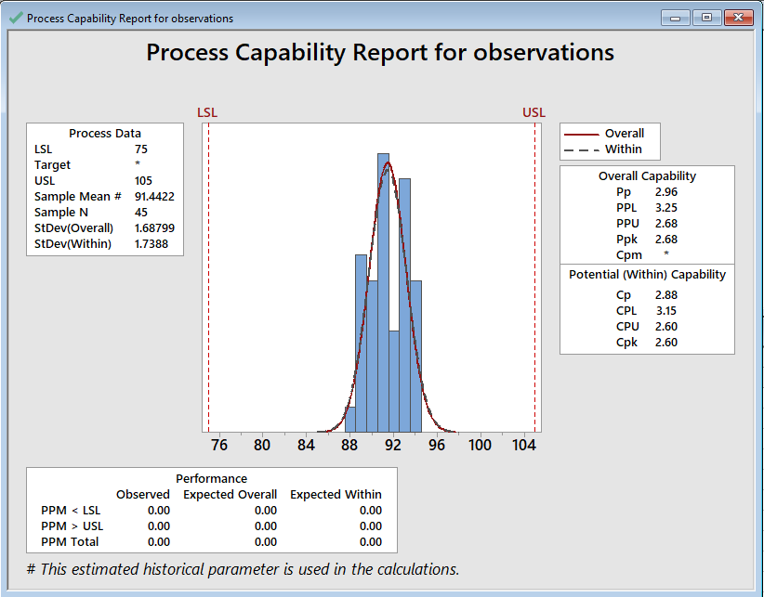
After Applying DMAIC
Cpk =2.60

Slide 19
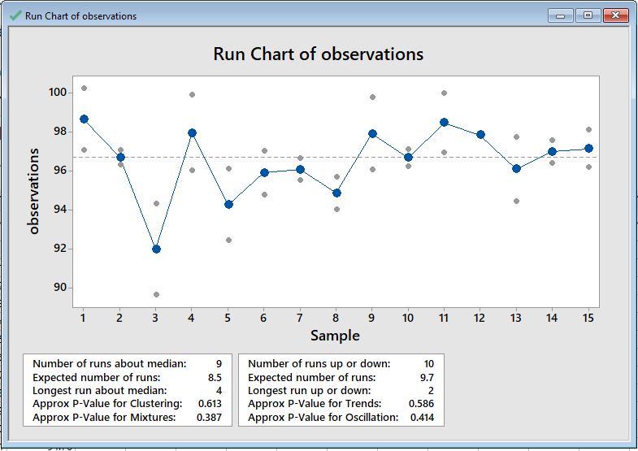
Run chart before improvement

Slide 20
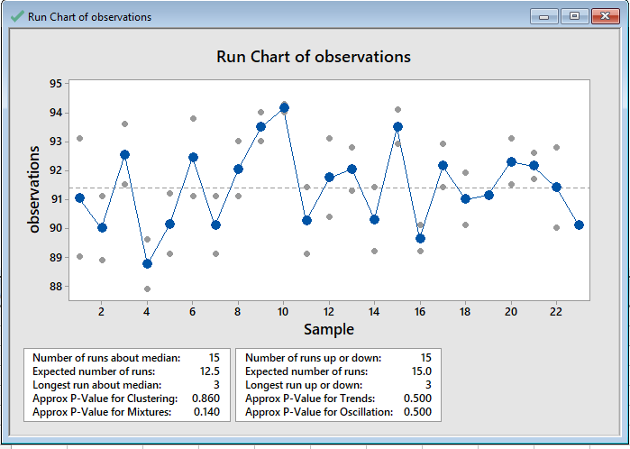
Run chart after improvement

Slide 21
Environment & sustainability
Our MSQC Project, entitled Application of Six Sigma in Tire Manufacturing, is directly related to the sustainable environment. According to United Nations Sustainable Development Goals (SDGs), our project directly relates to the following goals:
Goal 8: Decent Work and Economic Growth
Monitoring Tire Quality In Automobile Sector Promotes The Economic Growth Of The Country. Pakistan Rubber Tire Market Size Was Valued At $272.10 Million In 2017, And Is Projected To Reach $1,592.90 Million By 2025, Registering A CAGR Of 24.8% From 2018 To 2025. The Radial Type By Design Segment Was The Highest Revenue Contributor In 2017, Accounting For $207.7 Million, And Is Estimated To Reach $1,196.4 Million By 2025, Registering A CAGR Of 24.6% During The Forecast Period.
Goal 12: Responsible Consumption and Production
This project aims at the responsible consumption of the tire quality and the production of the Rubber Tire Industry.

Slide 22
Contd.
Goal 13: Climate Action:
This project is directly related to the climate actions because when wastes from Tire Manufacturing sector are released in the air or pollutants in water, they effect the climate and create hazardous effects.
Goal 15: Life on Land:
Monitoring of Tire quality using Six Sigma implementation improves the life on land because according to this sustainability goal, life on the land should be good for all. So, when tire quality will be good, it will create good impact on the climate and society.

Slide 23
Conclusion
In our project, DMAIC approach was implemented for process improvement in tire industry. First, process capability index Cpk of the current process was computed which was found to be 1.31.
In addition, substantial analysis of existing system was done for finding the solution of root cause identified.
Plant can be improved significantly by implementing six-sigma DMAIC methodology.
The main aim of this study was to improve the process capability index of the bead splice, which is achieved by increasing the value of process capability index up to 2.60.
All the results are obtained using the MINITAB 2018 because of its ease of use.

Slide 24

Thank you

